Slide 1
Exception handling
Unit 5

Slide 2
3 types of errors
Syntax errors-compiler
Logical errors-debugger
runtime errors

Slide 3
Runtime errors
Bad inputs
Un availability of resources
Run time errors are also called as exceptions

Slide 4
syntax
Try
{
1.
2.
3.
}
Catch()
{
// statements inside the catch block will be executed only when an error is raised in try block
}

Slide 5
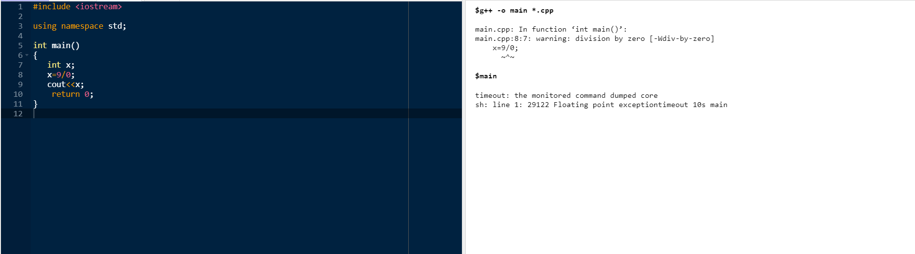

Slide 6
Errors can be broadly categorized into two types
Compile Time Errors – Errors caught during compiled time is called Compile time errors. Compile time errors include library reference, syntax error or incorrect class import.
Run Time Errors - They are also known as exceptions. An exception caught during run time creates serious issues.
Errors hinder normal execution of program. Exception handling is the process of handling errors and exceptions in such a way that they do not hinder normal execution of the system. For example, User divides a number by zero, this will compile successfully but an exception or run time error will occur due to which our applications will be crashed. In order to avoid this we'll introduce exception handling technics in our code.

Slide 7
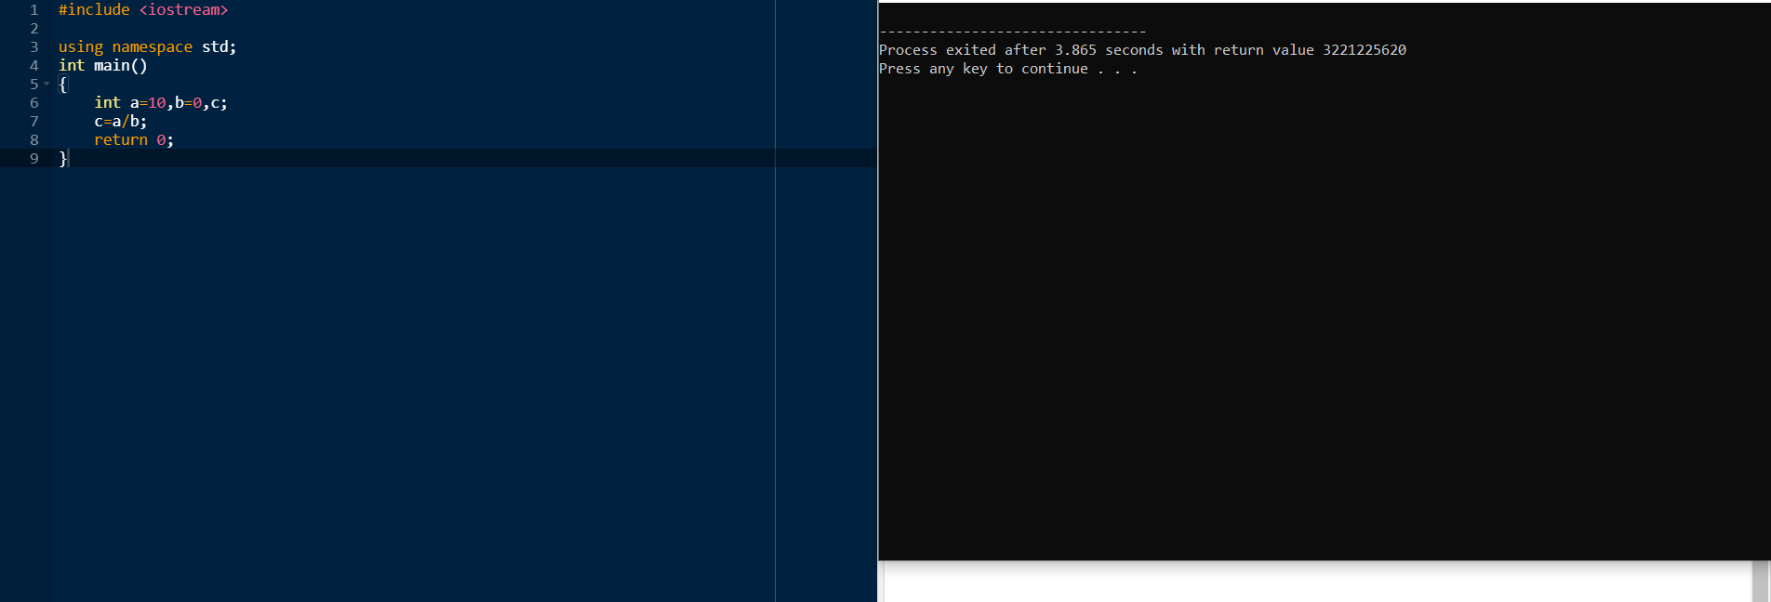
Understanding Need of Exception Handling

Slide 8
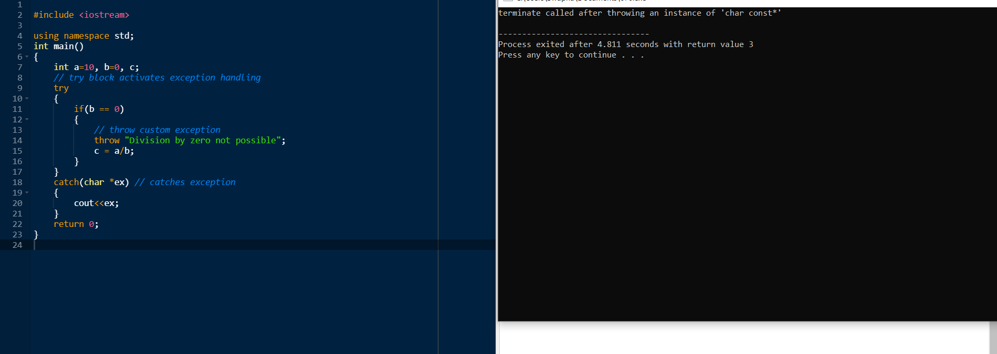

Slide 9
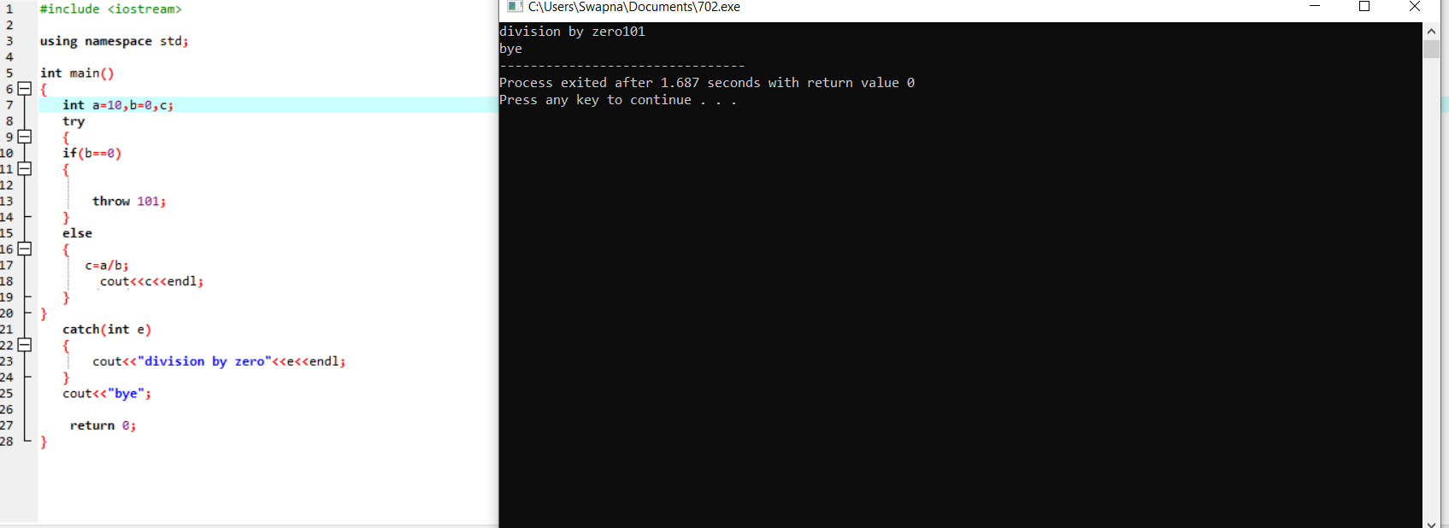

Slide 10
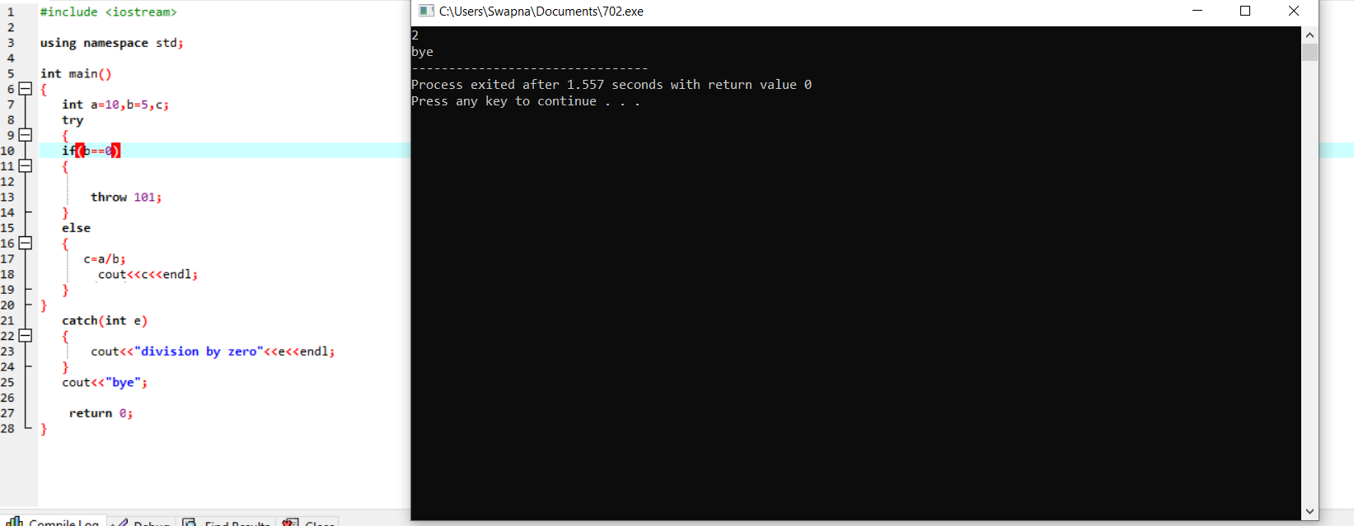

Slide 11
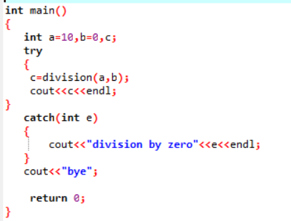
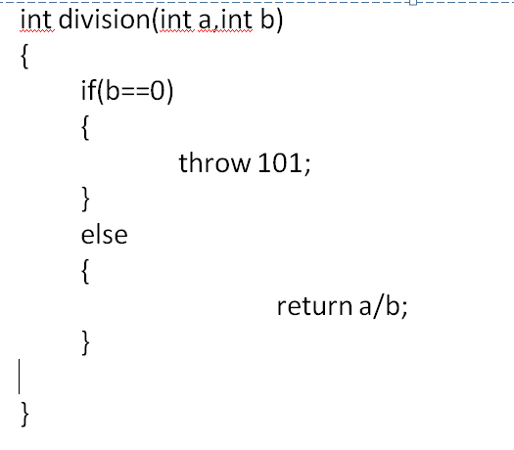
Throw and catch between functions when an error raised in called function

Slide 12
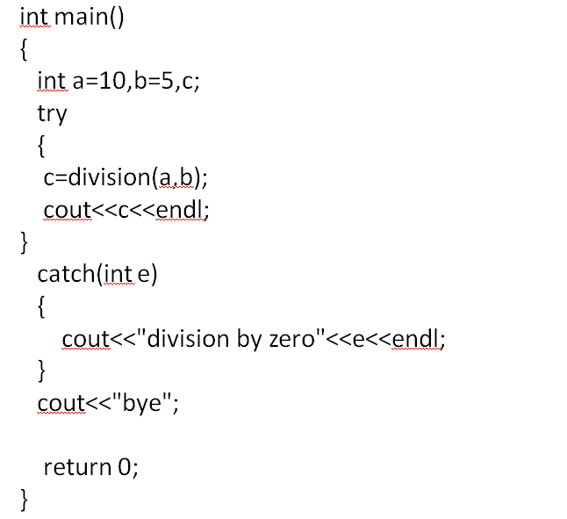
Throw and catch between functions when there is no error in calling function

Slide 13
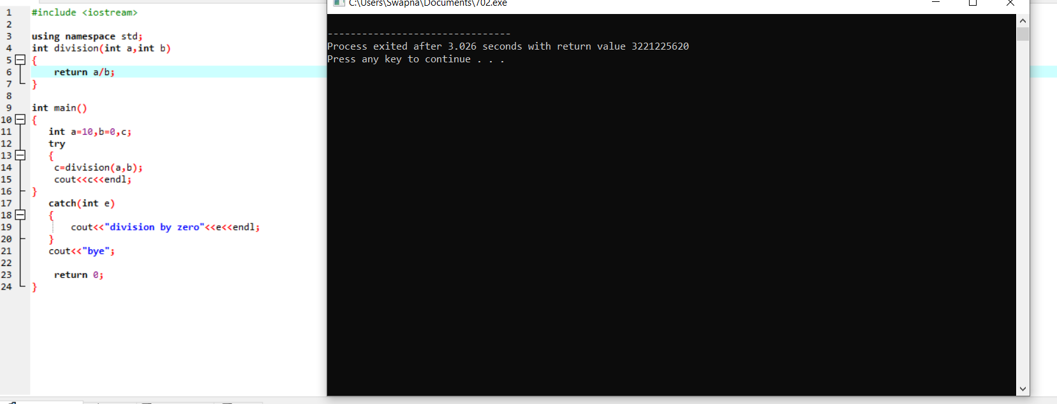

Slide 14
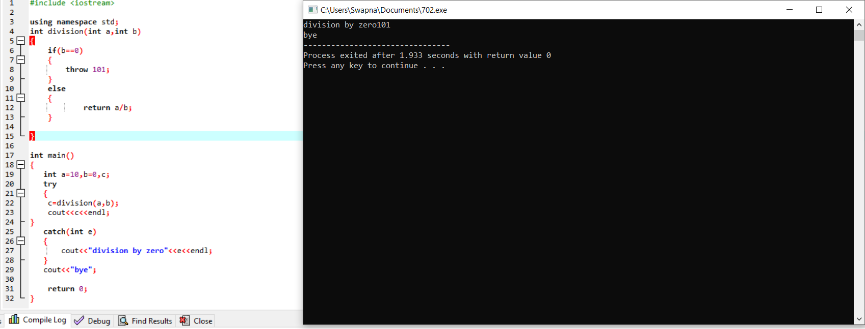

Slide 15
